Slide 1

Go, change the world
RV College of
Engineering
Modelling, simulation RFID devices, materials and engineering applications
Student 1 : Aditya Manjunatha USN:1RV21EC009
Student 2 : Mohammed Asim USN:1RV21EC099
Student 3 : Sourish G USN:1RV21EC167
Student 4 : Uby H USN:1RV21EC180

Slide 2

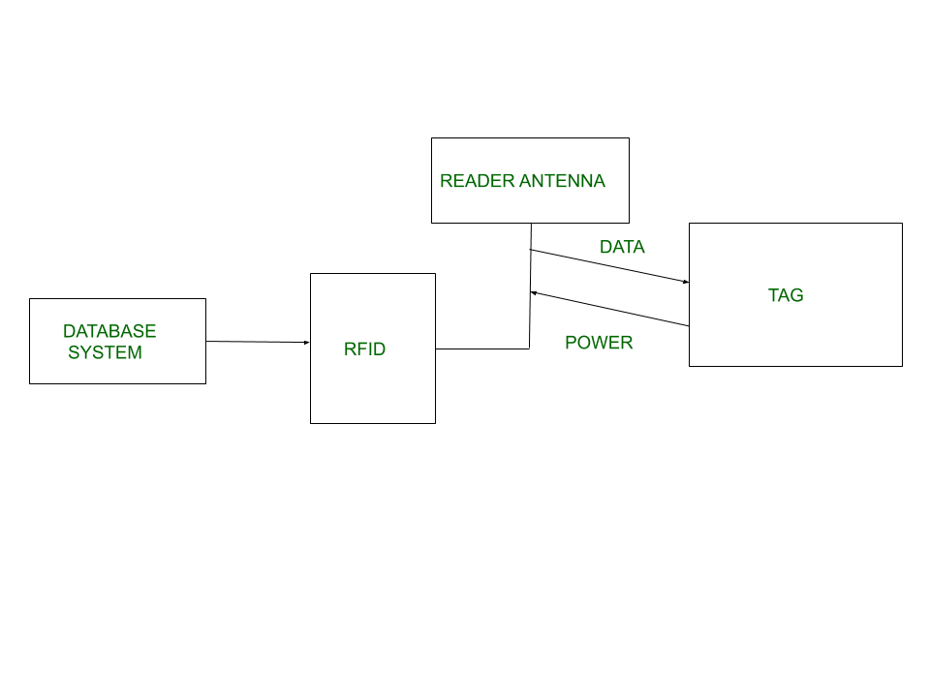
RV College of
Engineering
Go, change the world
Introduction to RFID
The term RFID refers to Radio Frequency Identification, a technology which uses radio waves to automatically identify items or people. Most commonly this involves the use of an RFID tag and a reader device.
The reader emits a field of electromagnetic waves from an antenna, which are absorbed by the tag. The absorbed energy is used to power the tag's microchip and a signal that includes the tag identification number is sent back to the reader.

Slide 3
RV College of
Engineering
Problem Statement
Go, change the world
In the traditional system of libraries there were a lot of flaws and many difficulties faced in keeping the track of the books borrowed and the books available. Then there was the introduction of bar code scanner which was initially a good system but later became a drawback as the bar code would easily get erased.
During the lunch breaks or other breaks most of the students' time is spent in standing in lines for the counter to collect the tickets and again wait for the food to be prepared and collected. Then always there is no ample amount of time for the students to eat peacefully during the lunch breaks and other breaks just due to this inefficiency in the cafeteria.
Most of the students miss their attendance because they couldn’t listen to their names during the rollcall. Due to which many of the students though present in the class are marked absent. Ultimately they end up having an attendance shortage.
Students mostly are not able to access and make use of college facilities to their maximum benefit. This also includes the many paid software, students can use for their better learning, project work, easier understanding of the concepts etc. for free by using the college’s email id.
Students majorly face issues and also a big security threat when paying fees. Mostly these are due to the slow and unresponsive banking servers, the delay in the OTPs due to which the transaction can get failed and also some error due to which the amount would have been deducted from their account and not reflecting in the college’s bank account.

Slide 4
RV College of
Engineering
Methodology
Go, change the world
We provide every student with a unique RFID card which has a unique number associated with it which can be read by the RFID tag reader.
The number is then related to the user through methods of coding.
The student with the card can access the facilities of the college, can give attendance through the card by scanning it to the reader. So, the students ID card can be made as an RFID card with an unique number to it which can be used for multiple purposes in college.

Slide 5
RV College of
Engineering
Objectives
Go, change the world
Students’ ID cards can be used as canteen card.
Students’ ID cards can be used to issue books in libraries.
Students’ ID cards can be used to take attendance for every class.
Students’ ID cards can be used as access control in facilities.
Students’ ID cards can be used as atm/metro cards.

Slide 6
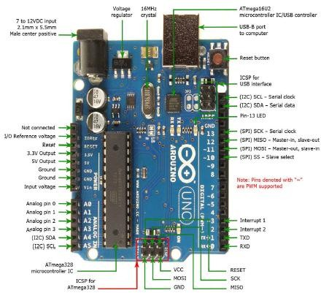
RV College of
Engineering
Arduino UNO
Go, change the world
The Arduino Uno is an open-source microcontroller board. The board is equipped with sets of digital and analog input/output (I/O) pins that may be interfaced to various expansion boards (shields) and other circuits. The board has 14 digital I/O pins (six capable of PWM output), 6 analog I/O pins, and is programmable with the Arduino IDE (Integrated Development Environment), via a type B USB cable. It can be powered by the USB cable or by an external 9-volt battery.

Slide 7
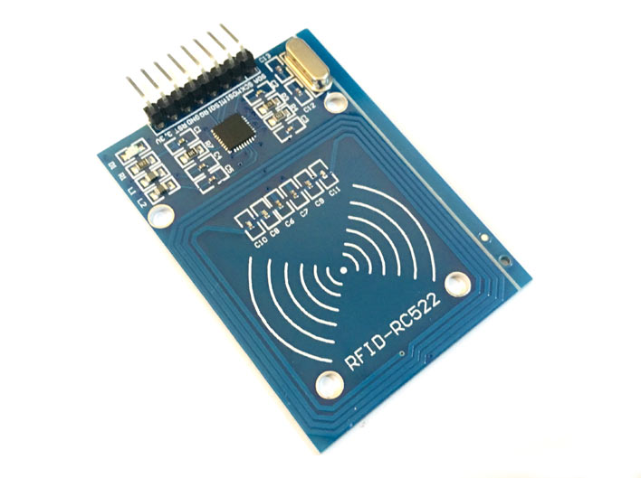
RV College of
Engineering
Hardware Components
Go, change the world
RFID Reader:
RFID reader is a device which transmits radio waves using a signal generator through antenna. These waves hits the object and a feedback signal is generated back to the receiver so that the object can be identified.

Slide 8
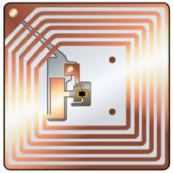
RV College of
Engineering
Go, change the world
RFID Tags:
Tags are the devices, of which information is to be tracked.
There are two types of RFID tags:
Passive tags: A passive RFID tag is powered by the electromagnetic energy, radiated from RFID reader antennas, based on back scattering. A passive tag can’t transmit radio waves of its own, and its information storage capacity and computing capability are limited. It can be read only at short range (0.6 to 3 meters).

Slide 9
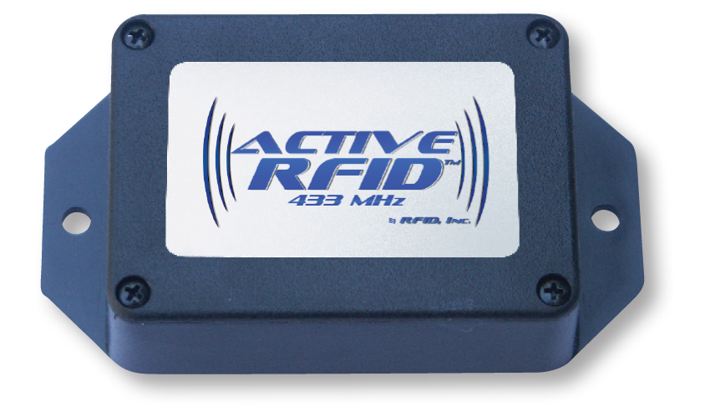
RV College of
Engineering
Go, change the world
Active tags:
An active tag is powered by an on-board long-life battery that provides sufficient energy to allow independent communication capability within greater range (approximately 90 meters).

Slide 10
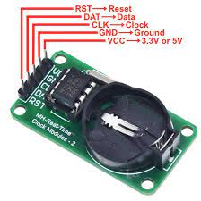
RV College of
Engineering
REAL TIME CLOCK (RTC)
Go, change the world
RTCs must accurately keep time, even when the device is powered off because, it is often used as a trigger for turning the device on or triggering events such as alarm clocks. RTC ICs run on an alternate power source, which allows it to continually operate under low power or even when the computer is turned off. ICs on older systems utilize lithium batteries, whereas newer systems make use of auxiliary batteries or supercapacitors. RTC ICs that use supercapacitors are rechargeable and can be soldered. But inmost consumer-grade motherboards, the RTC is powered by a single battery that, when removed, resets the RTC to its starting point. RTC ICs regulate time with the use of a crystal oscillator and do not rely on clock signals like most hardware clocks. Aside from being responsible for the timing function of the system.
Department of ECE
10

Slide 11
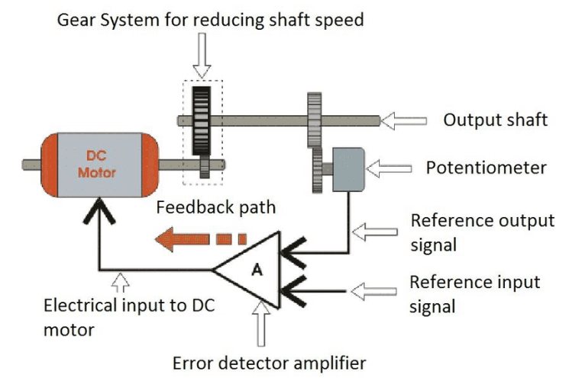
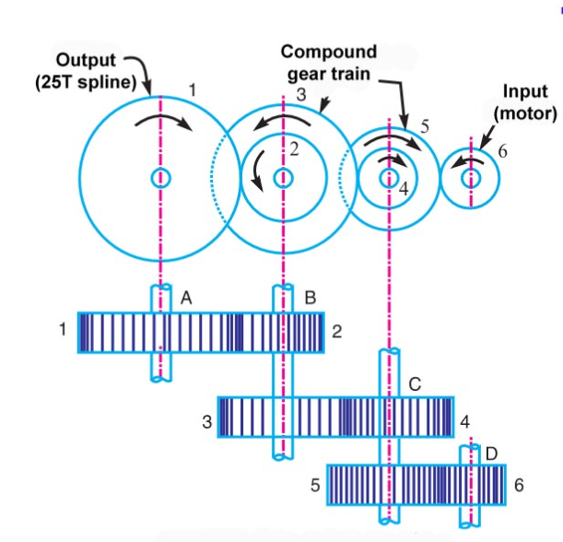
RV College of
Engineering
Working Principle of Servo Motor
Go, change the world
One of the functions of servo motor is the angular precision achieved and the torque. The angular precision is achieved by the potentiometer. The high torque is given with the help of the compounded gear train system which is connected to the teeth of the DC Motor. As we know that DC motor gives very high speed but less torque. With the help of these multiple toothed gear trains this high speed and less torque would be outputted as less speed great torque.
In compound gear train the gears are connected in series but the two or more gears connected in such a way that both gears rotate about the same axes of rotation with the same angular velocity. The intermediate shafts have more than one gear but the input and output shafts have only single gear for transmit power. The compound gears have much larger speed reduction ratio as compared to simple gear train.

Slide 12
RV College of
Engineering
Outer casing of RFID
Go, change the world
RFID inlays are sometimes encapsulated inside a hard case. The case is made of RF translucent materials such as PET, Polypropylene (PP), Polyacetate (POM), Polycarbonate (PC).
Polypropylene (PP) is a thermoplastic “addition polymer” made from the combination of propylene monomers.
Polycarbonates (PC) are a group of thermoplastic polymers containing carbonate groups in their chemical structures. Polycarbonates used in engineering are strong, tough materials, and some grades are optically transparent. They are easily worked, molded, and thermoformed.
Polypropylene

Slide 13
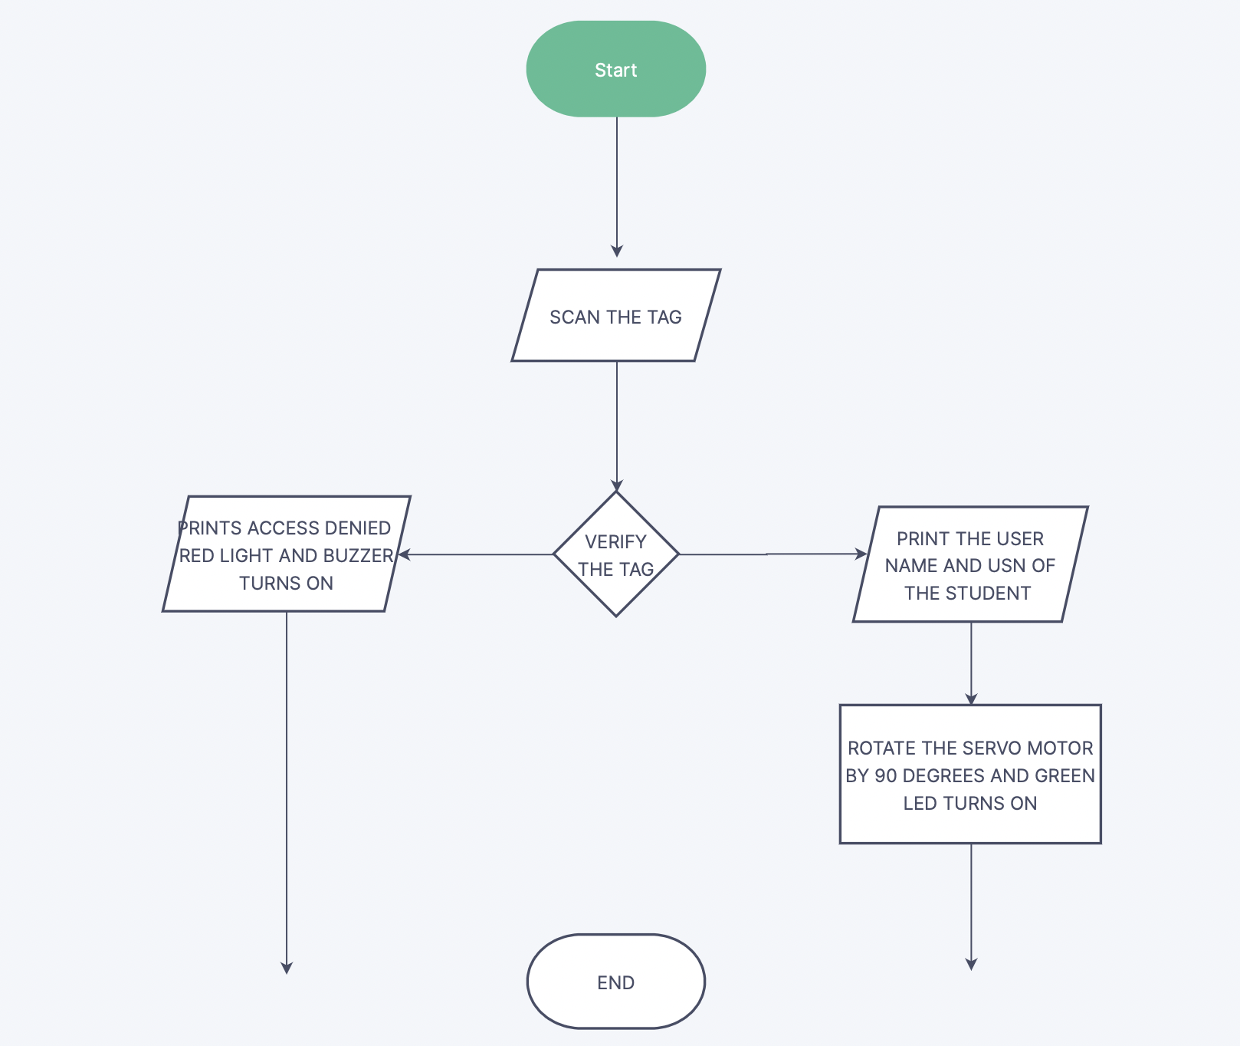
RV College of
Engineering
Flowchart
Go, change the world
NO
YES

Slide 14
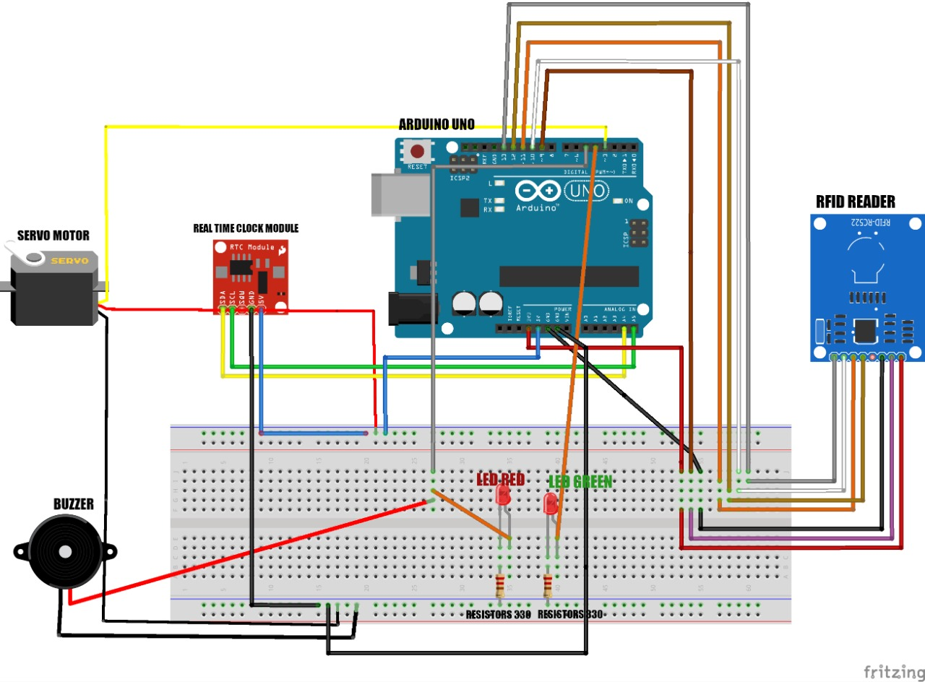
RV College of
Engineering
CIRCUIT DIAGRAM
Go, change the world

Slide 15
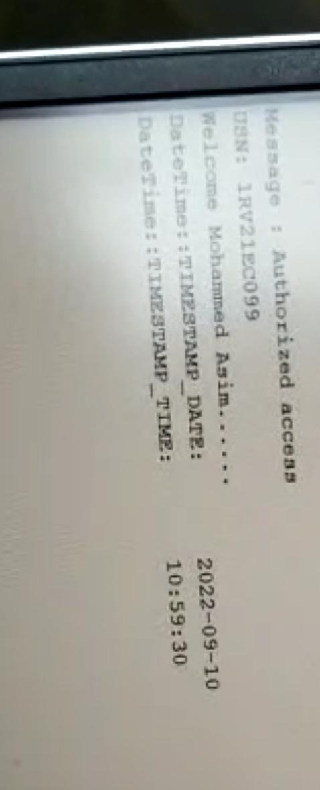
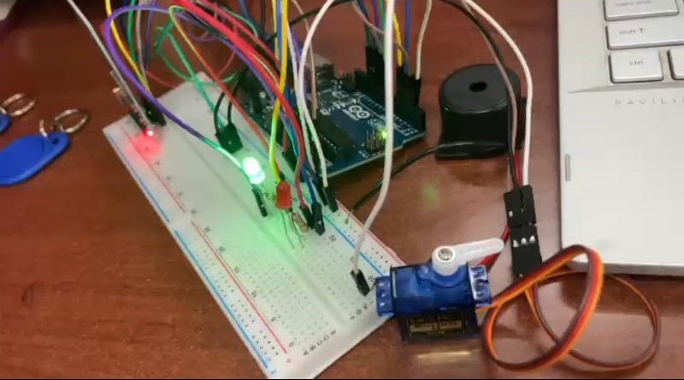
RV College of
Engineering
Implementation
Go, change the world
For valid tags

Slide 16
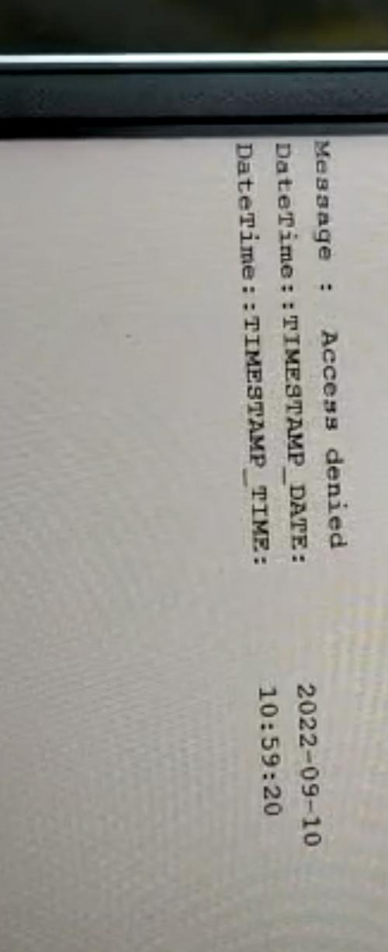
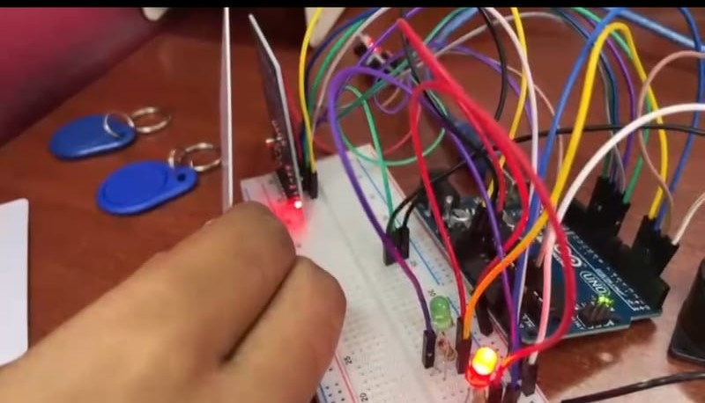
RV College of
Engineering
Implementation
Go, change the world
For invalid tags
Department of ECE
16

Slide 17
RV College of
Engineering
Engineering Applications of RFID
Go, change the world
Product Tracking
Toll Road Payments
Passports
Shipping
Tap-and-go credit card payments

Slide 18
RV College of
Engineering
References
Go, change the world
https://www.graphene-info.com/graphene-introduction
http://www.u.arizona.edu/~obaca/rfid/uses.html
https://www.techtarget.com/iotagenda/definition/RFID-radio-frequency-identification
https://www.researchgate.net/publication/232575248_THE_RFID_TECHNOLOGY_AND_ITS_APPLICATIONS_A_REVIEW
https://www.arduino.cc/en/software
Department of ECE
15

